Slide 1
Chapter 6 & 7 Objectives
Understand common types of DNA damage and how they are repaired
Be able to describe limitations to different DNA damage repair mechanisms
---------------------------------------------------------------------------------------------
Understand and be able to describe the key steps in transcription
Understand and be able to describe 3 types of RNA processing: how they happen and what they are for
Understand how mRNA is decoded by the ribosome to synthesize protein
Appreciate how different RNA molecules cooperate in translation

Slide 2
Dna damage
Mismatch repair

Slide 3
Assault on your genome
The human body has ~30 trillion cells
~10,000 trillion cell divisions in a lifetime
200 million cells are replicating DNA and dividing in your body RIGHT NOW
Daily exposure to DNA damaging factors:
Lifestyle factors (nutrition, tobacco use, etc)
Naturally occurring exposures (UV light, infectious agents)
Medical treatments (chemotherapy)
Workplace and household exposures
Pollution
Each round of replication is an opportunity for new mutations to be acquired and passed on

Slide 4
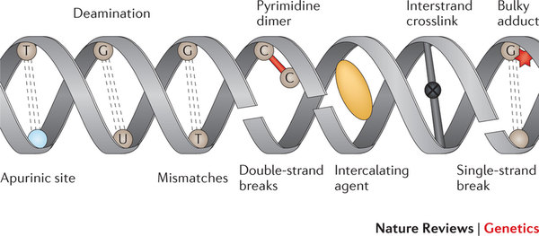
Common types of damage
Caused by both endogenous and exogenous sources
Mismatch errors during replication 1:10,000,000
2 of the more common: deamination and depurination
N-glycosidic bond that attaches the base to the sugar of a nucleotide is easily broken
Occurs with 10^4 bases per cell per day!

Slide 5
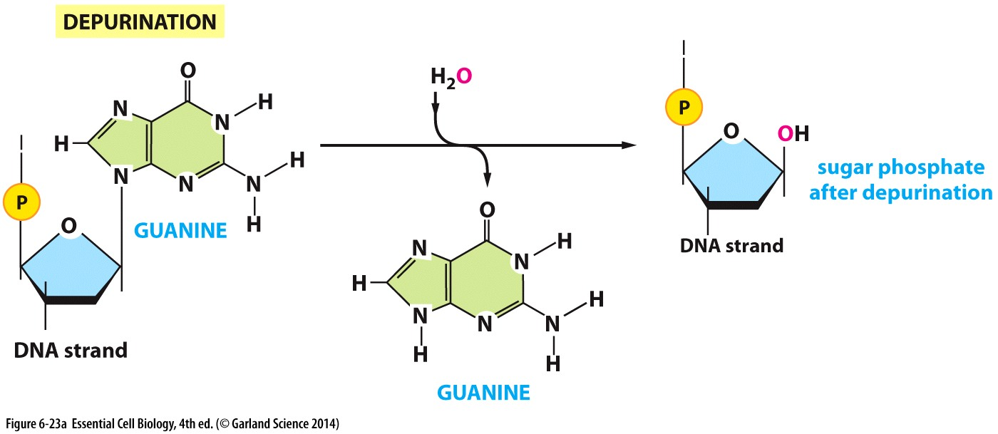
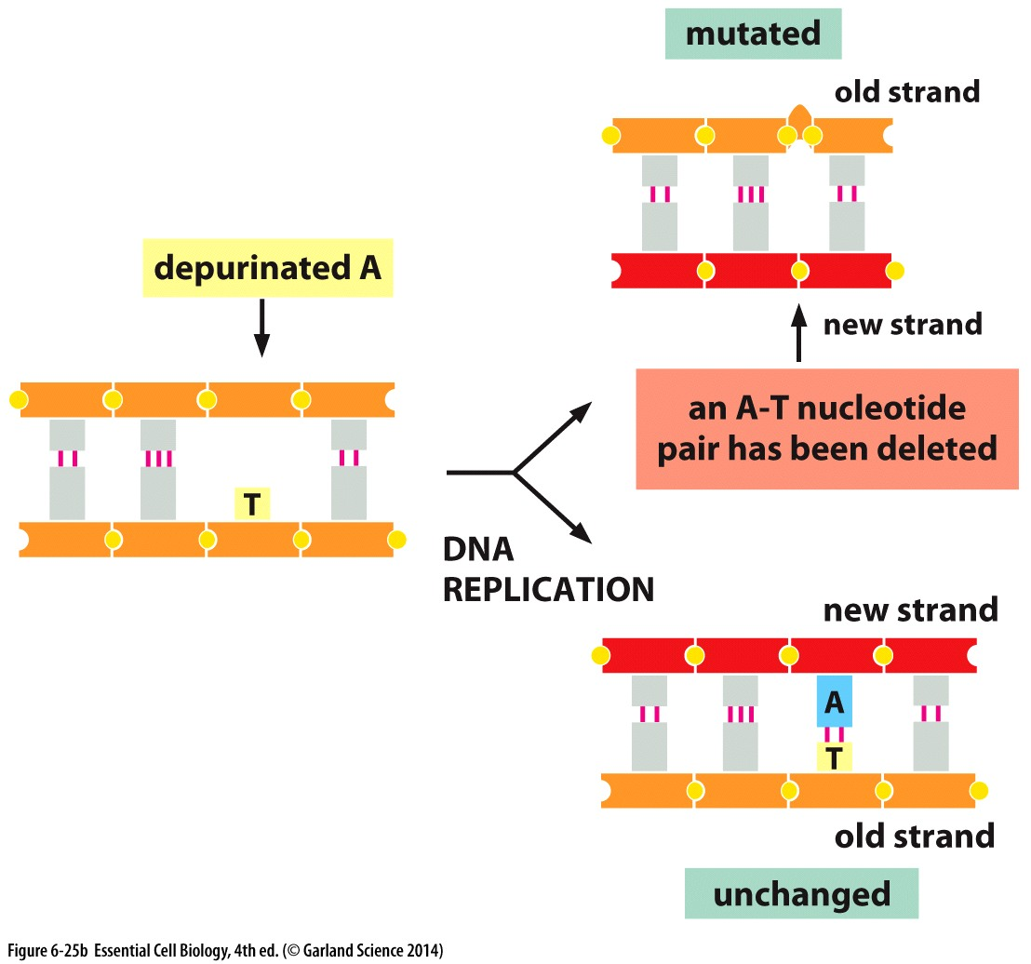
Internal assaults on DNA
Result of chemical reaction with acidic metabolites
Depurination → removes adenine or guanine
Similar but much less common with pyrimidines
Does not disturb the backbone
Results in nucleotide gaps
When replicated, new strands have deletion of bases

Slide 6
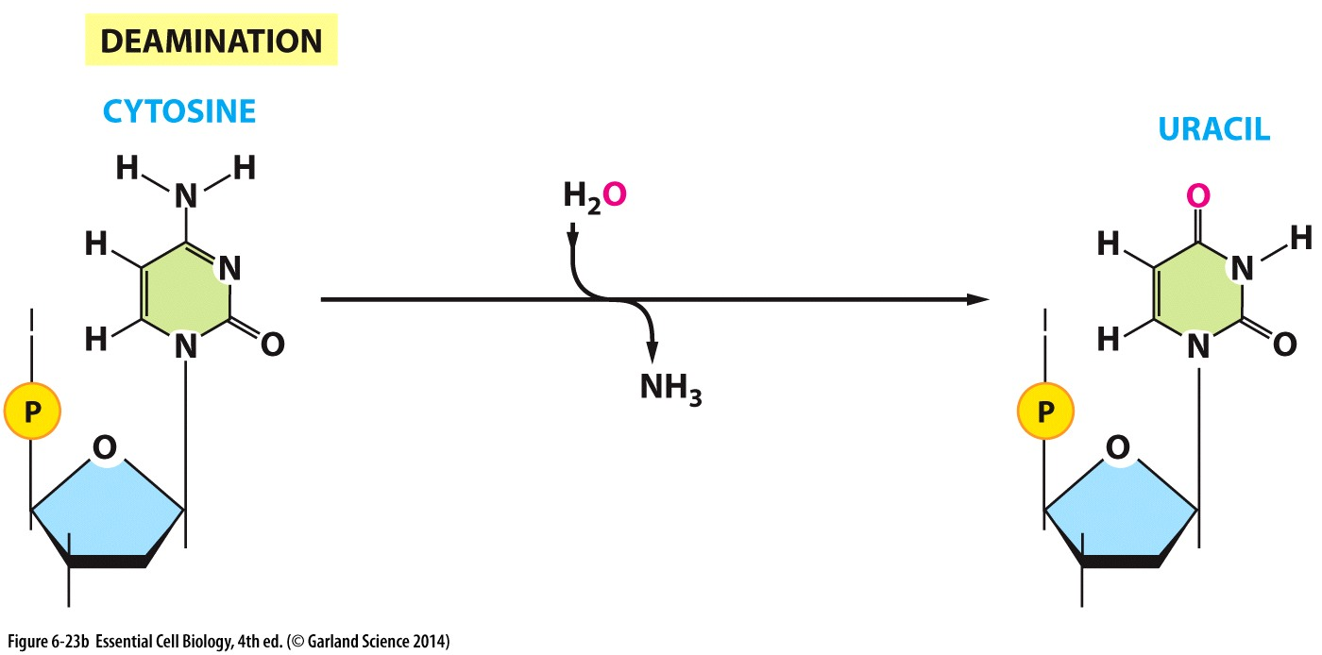
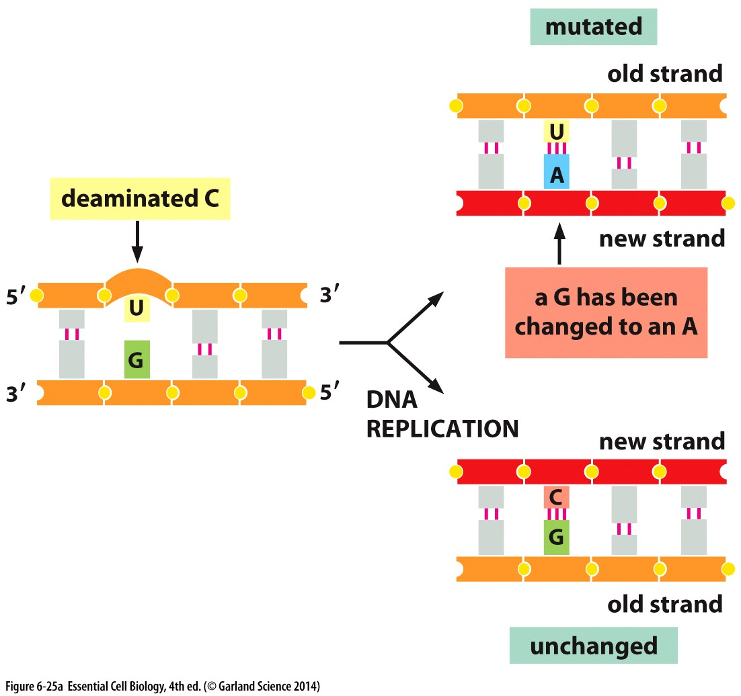
Defects from internal sources
Deamination → removes an amino group
Alters hydrogen bonding and allows pairing with different bases
When replicated, new strands have wrong base = mutation

Slide 7
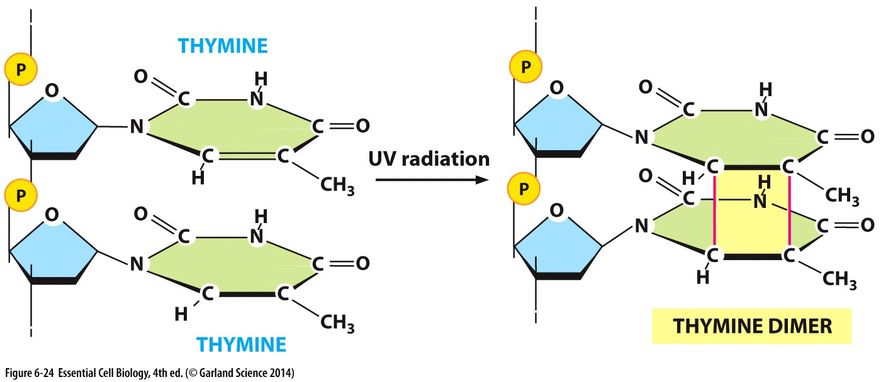
Defects caused by external sources
Pyrimidine dimers → UV light can induce covalent crosslinks between adjacent thymidine nucleotides
Can stall the replication machinery and prevent completion of replication

Slide 8
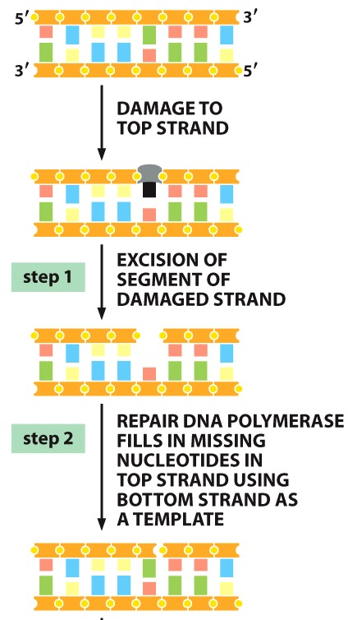
Identifying and fixing errors
Errors:
Base mis-matching
DNA polymerase errors, or DNA damage before replication
Stalled replication
DNA crosslinks
The fix:
Remove the damage
Use other strand as a template to repair
Nucleases cleave the backbone to remove damaged nucleotide
DNA polymerase fills the gap
Ligase seals the nick in backbone
Similar to okazaki fragment processing

Slide 9
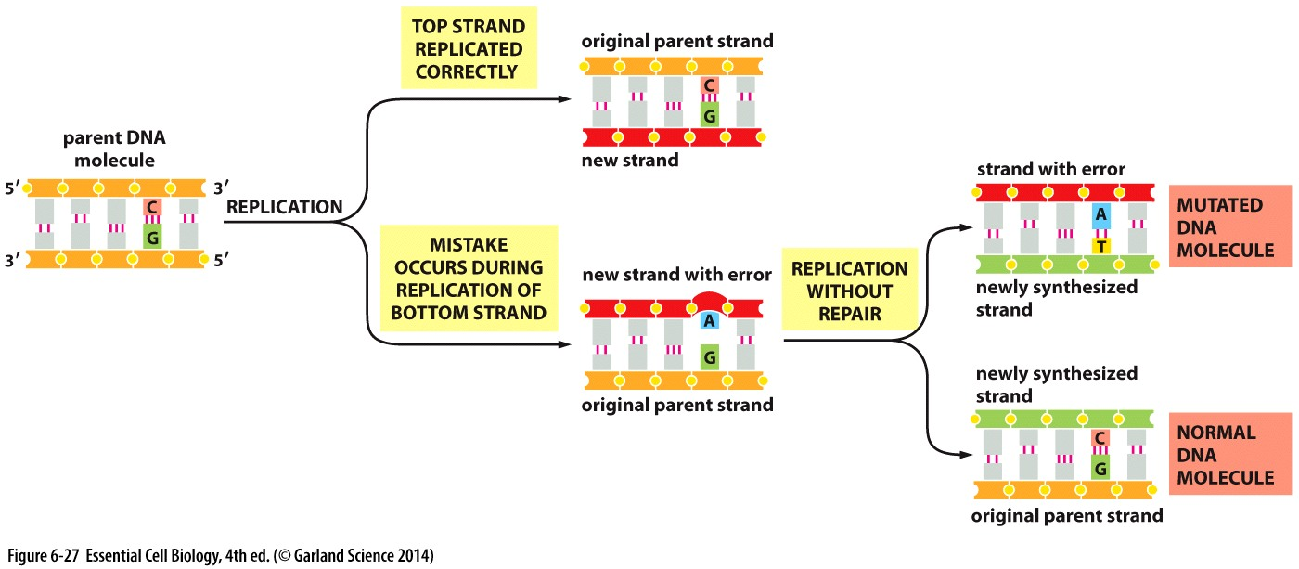
Damage must be identified and repaired BEFORE a new round of replication

Slide 10
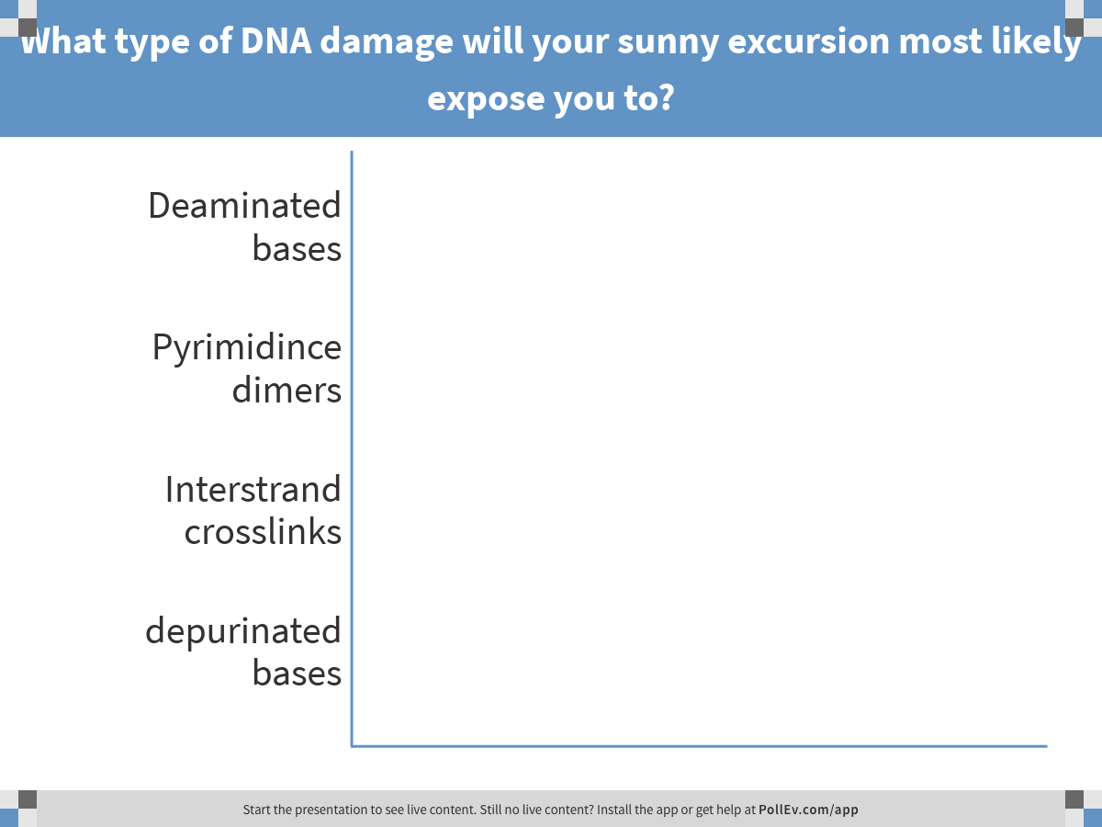
It finally stops snowing and the sun comes out so you decide to take a study break outside.
Notes:
What type of DNA damage will your sunny excursion most likely expose you to?
https://www.polleverywhere.com/multiple_choice_polls/efLbKBel29ApcIo

Slide 11
Common types of damage
UV light can crosslink pyrimidines like thymidine
Other damage need to be removed from BOTH strands → generate double strand breaks

Slide 12
Double strand breaks

Slide 13
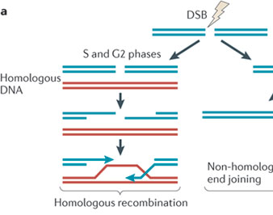
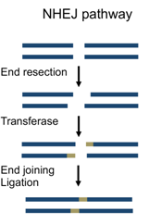
Repair pathway depends on cell cycle
Homologous recombination → lossless repair
Non-homologous end joining → loss of bases

Slide 14
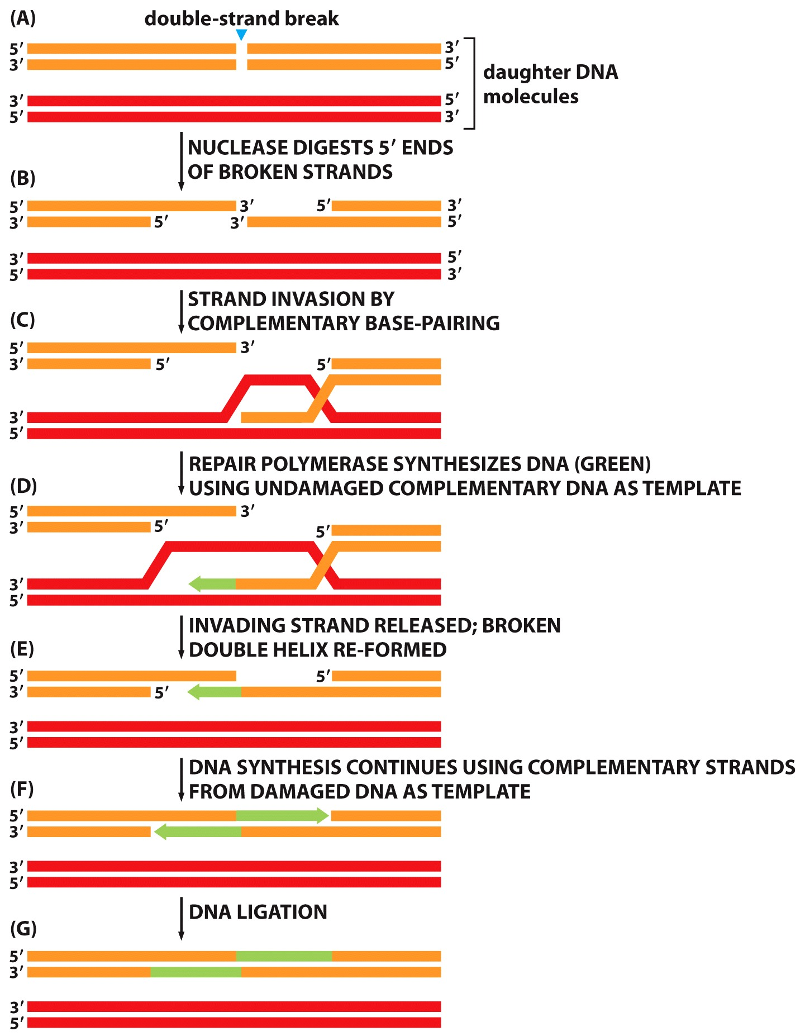
Homologous recombination
Requires a homologous chromosome
Post-replication & before mitosis
Multi-step repair pathway
Nucleases ‘chew’ the 5’ ends to create 3’ overhangs
Overhangs can invade a homologous double helix and find complementary bases
DNA replication using undamaged complementary DNA as template
DNA synthesis is completed
Nicks are ligated

Slide 15
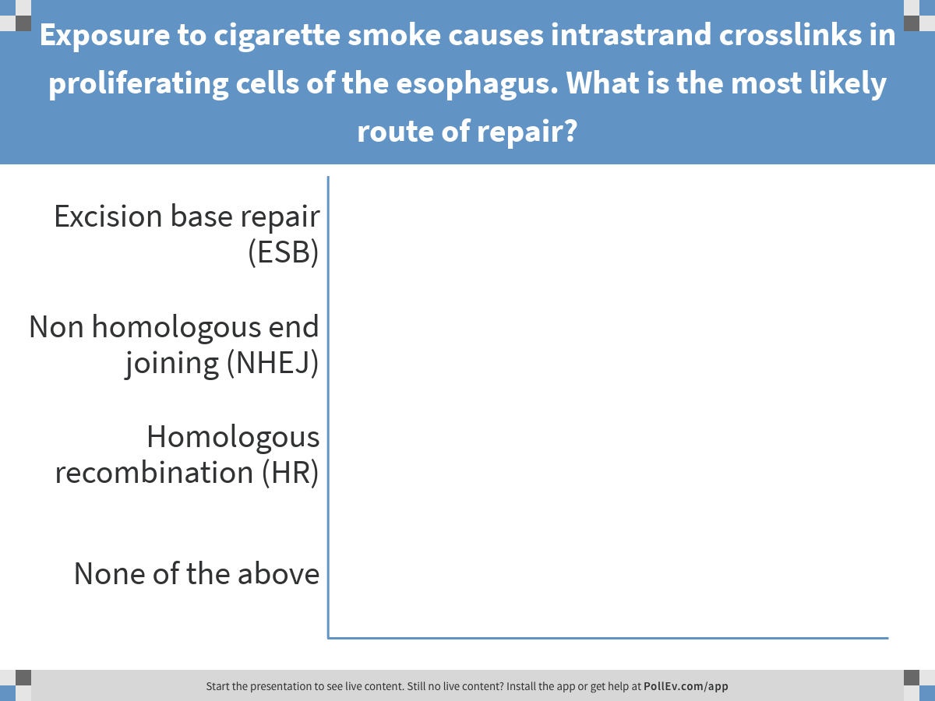
Notes:
Exposure to cigarette smoke causes intrastrand crosslinks in proliferating cells of the esophagus. What is the most likely route of repair?
https://www.polleverywhere.com/multiple_choice_polls/AO5AsqLMjJZvHSP

Slide 17
Dna to rna

Slide 18
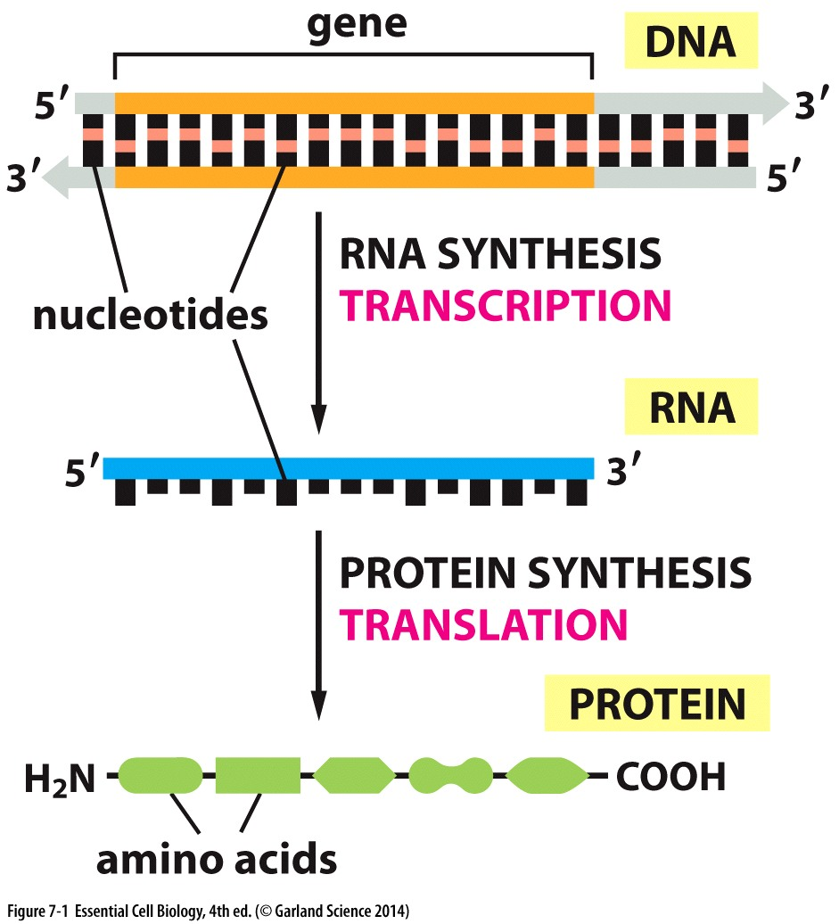
DNA uses: GCA&T
RNA uses: GCA&U

Slide 19
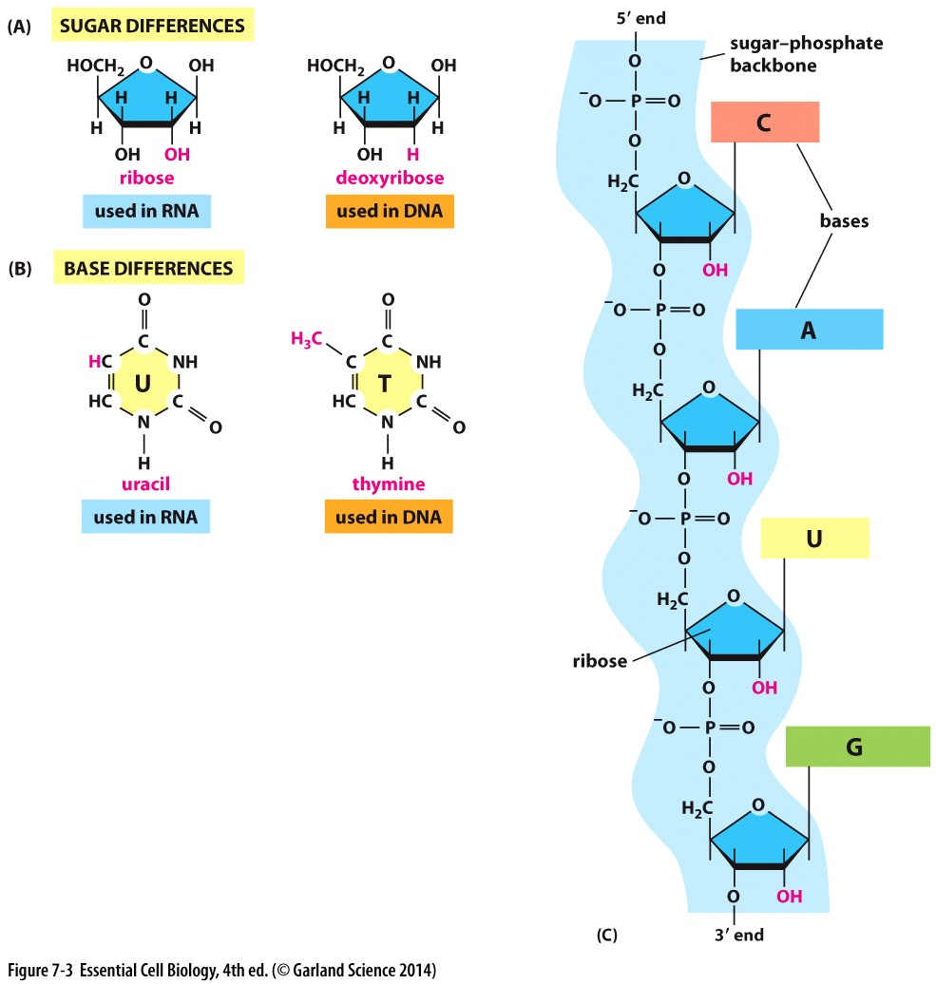
Different then DNA:
Different sugar
And different bases
Growing
Just like DNA:
RNA polymer grows 5’ to 3’
Nucleotides are added by a polymerase
Nucleotides are joined by phosphodiester bond

Slide 20
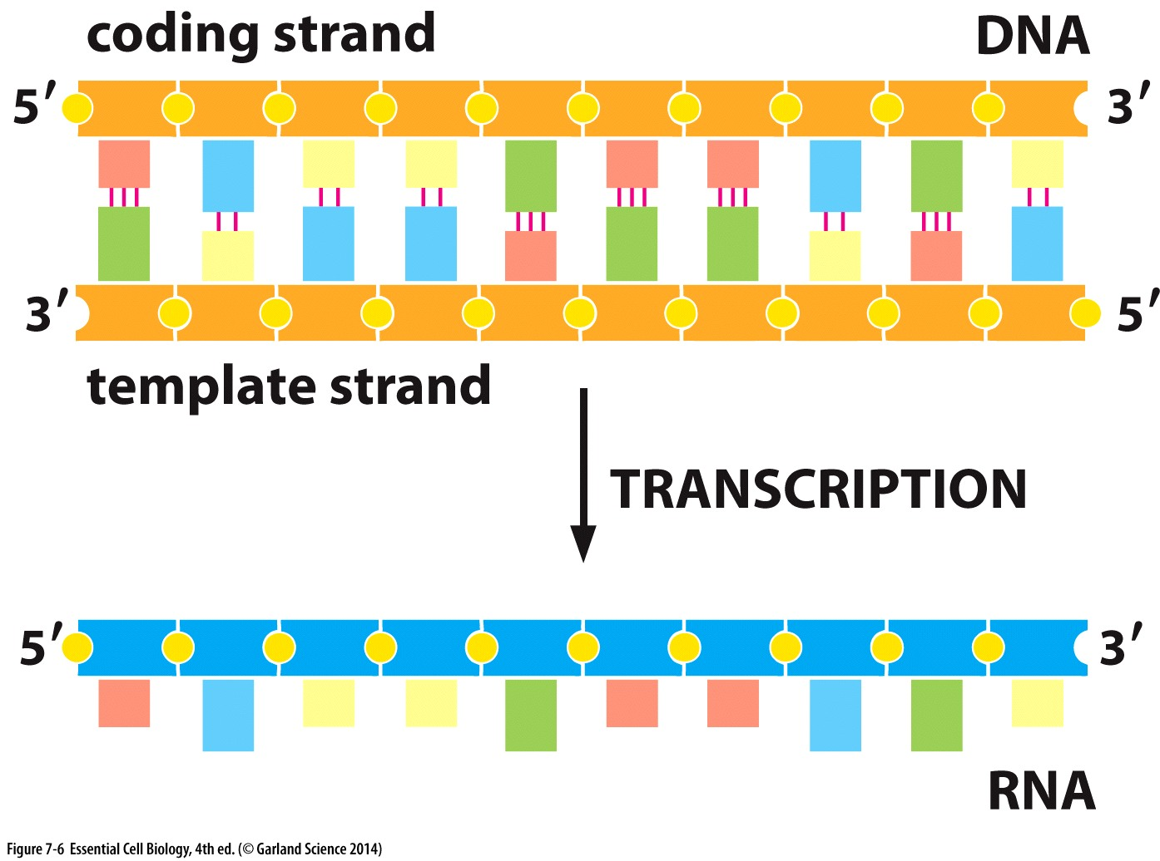
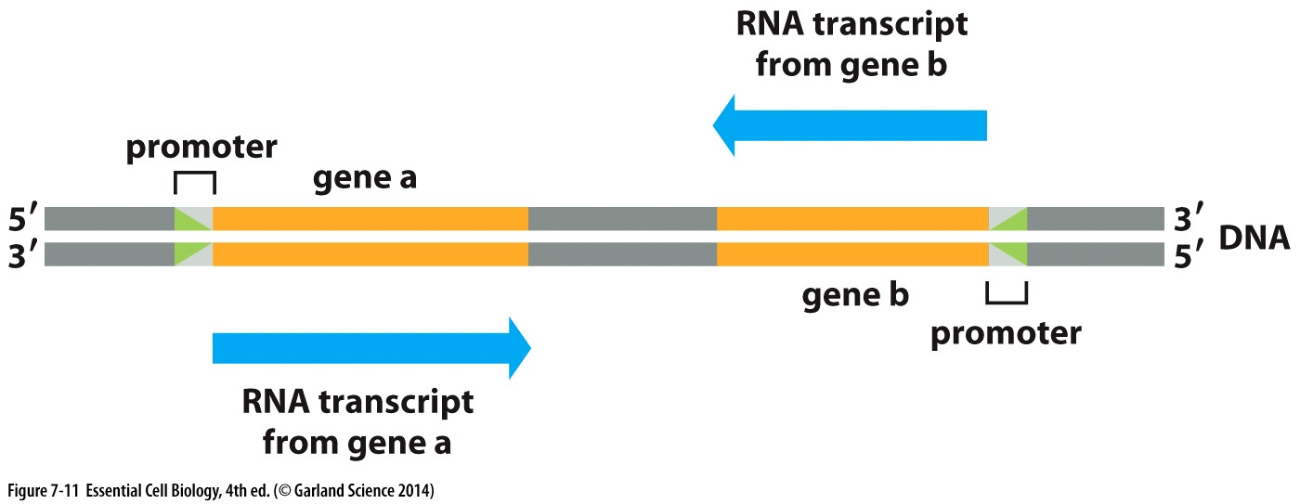
RNA polymerase uses DNA strand as a template
RNA is complementary to the template strand
RNA is identical to the coding strand
Genes to be transcribed on both strands
Both strands can serve as a template

Slide 21
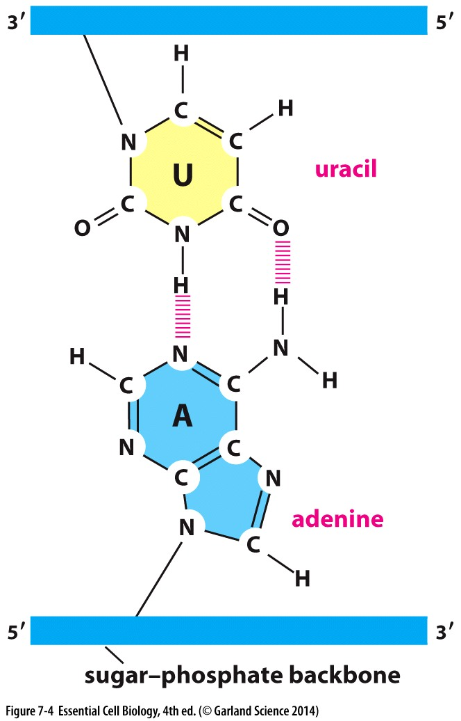
Complementary base pairing during transcription is stabilized by hydrogen bonds

Slide 22
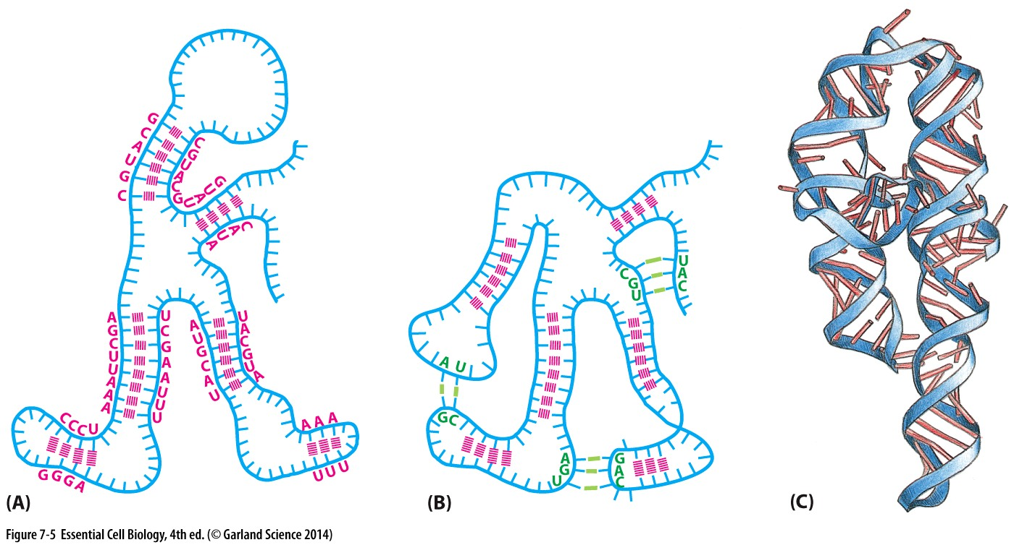
Base pairing for 3 D structure
RNA molecules can form intramolecular base pairs to assist and stabilize folding
Utilize both conventional and non-conventional base pairing

Slide 23
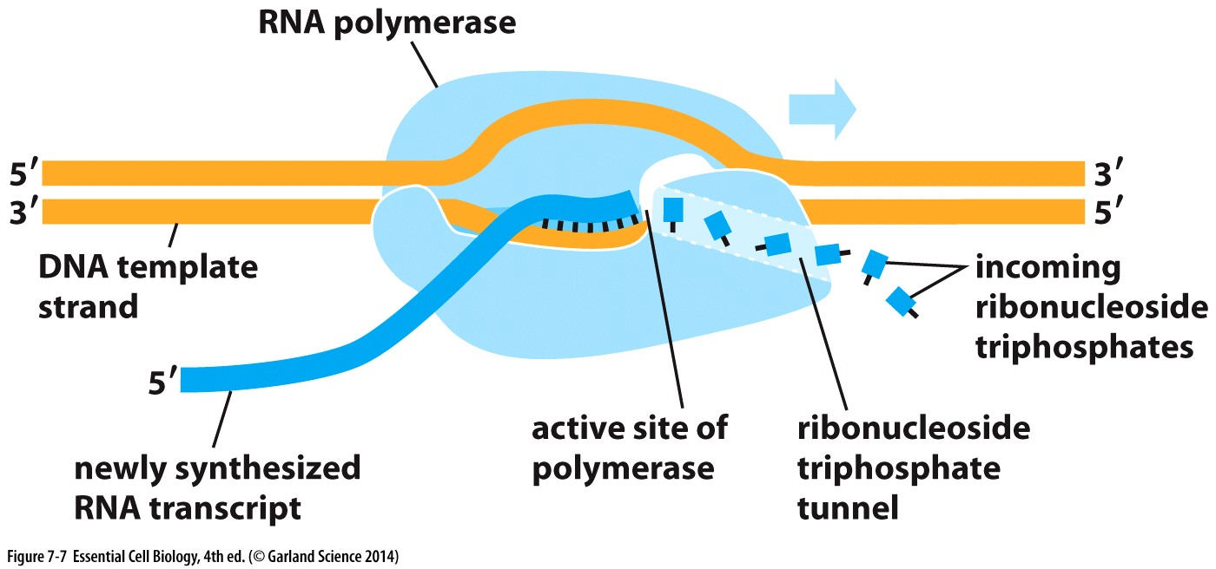
Polymerase to make RNA
Has an intrinsic helicase activity to unwind DNA double helix as it transcribes
After nucleotide is joined the polymerase moves on and displaces it’s pairing with DNA
DNA rewinds → doesn’t have the same supercoil issues as DNA replication

Slide 24
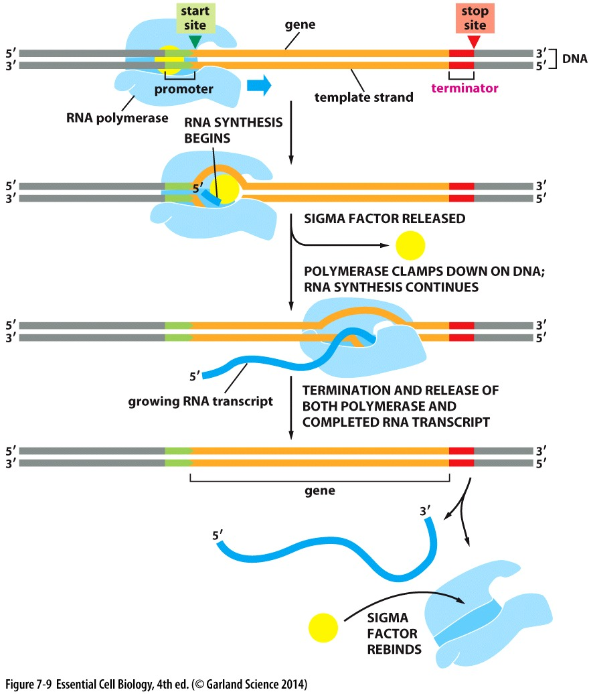
Knowing when to stop
Both where to start and where to stop transcription are indicated by specific DNA sequence
In bacteria:
Sigma factor-bound RNA pol can bind transcription start site
Sigma factor is released and RNA polymerization begins
At the termination site transcription ends
RNA pol releases RNA and DNA
Repeat

Slide 25
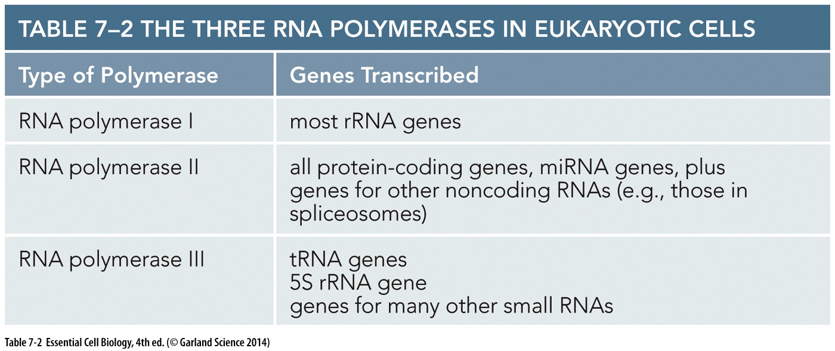
Complex transcription in eukaryotic cells
Many types of RNA → multiple specialized polymerases
Require transcription factors at promoter
Complex regulation of gene expression
Must content with nucleosomes
Gene expression = making a product that has a cellular function
From DNA→ protein requires transcription & translation
From DNA→ rRNAs, tRNAs, etc requires only transcription

Slide 26
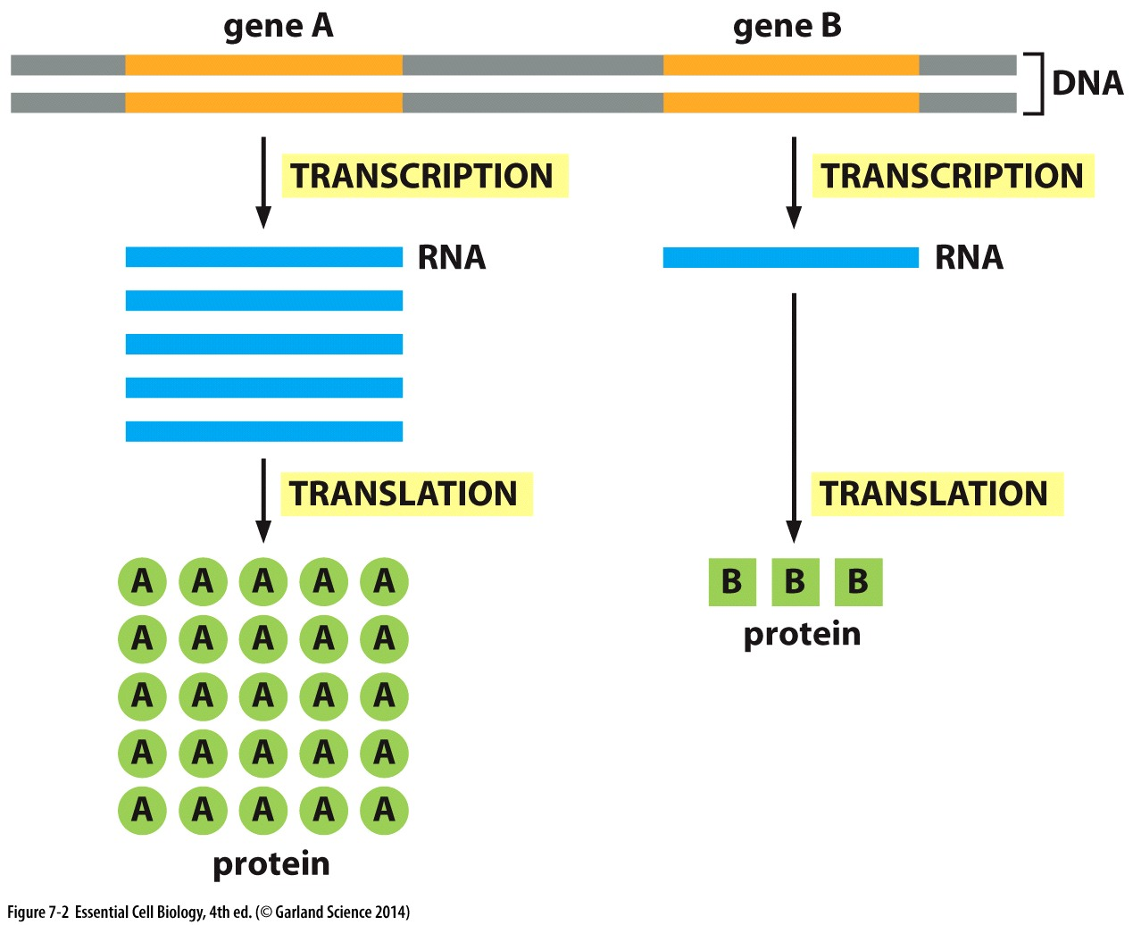
Regulating protein levels
A linear relationship
More transcription → more RNA
More RNA → protein

Slide 27
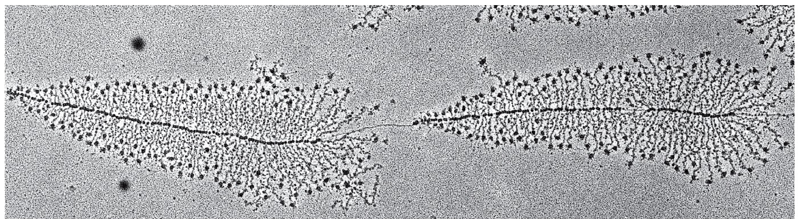
Regulating protein levels
A non-linear relationship:
The DNA template is reused → new rounds of transcription can begin before the first has finished

Slide 28
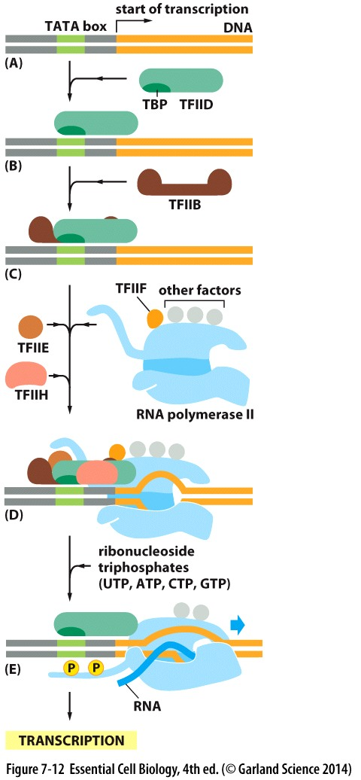
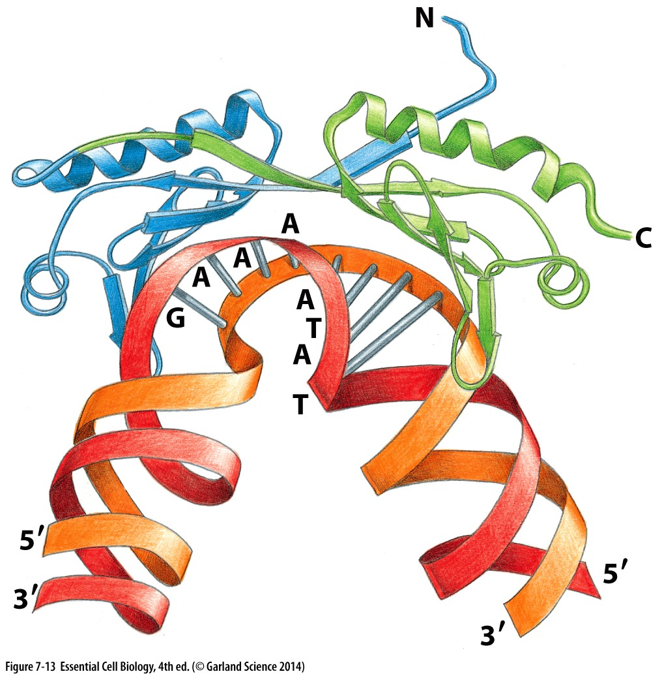
Initiating transcription
Transcription factor (TF) IID recognizes a T-A-T-A sequence in the promoter called the TATA box and binds
This binding is specific & contorts the DNA helix
Contortion promotes binding of other transcription factors

Slide 29
Initiating transcription
Transcription factor (TF) IID recognizes a T-A-T-A sequence in the promoter called the TATA box and binds
More general transcription factors & RNA Pol II bind:
TFIIH→ opens DNA double helix
TFIIH → phosphorylates RNA pol II
Pol II released from general transcription factors
→ transcription begins

Slide 30
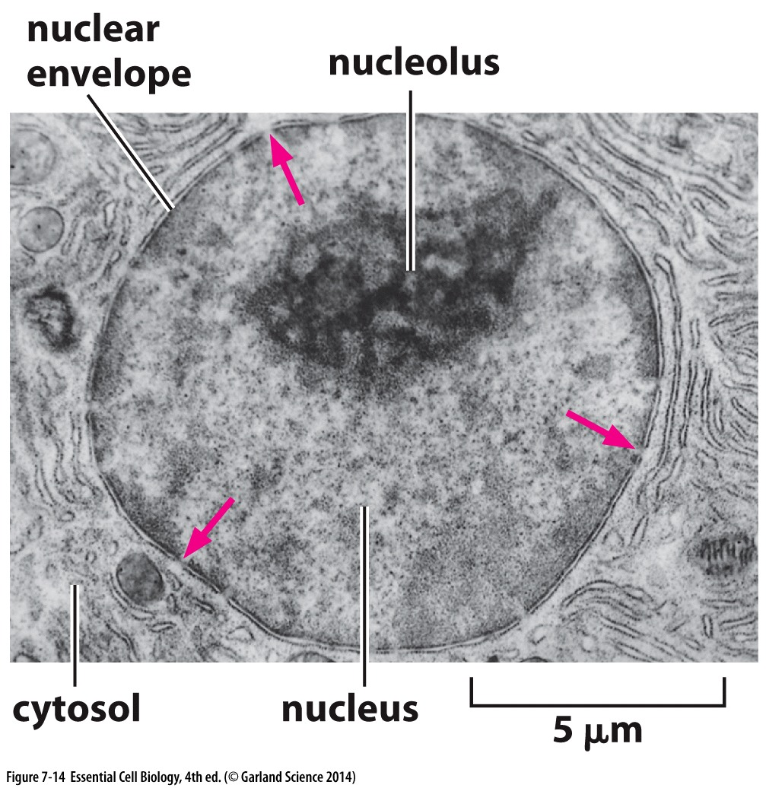
On to make protein?
Not yet!
DNA is in the nucleus
RNA is made in the nucleus
Protein-making machinery is in the cytoplasm
Before being exported, RNA is processed…

Slide 31
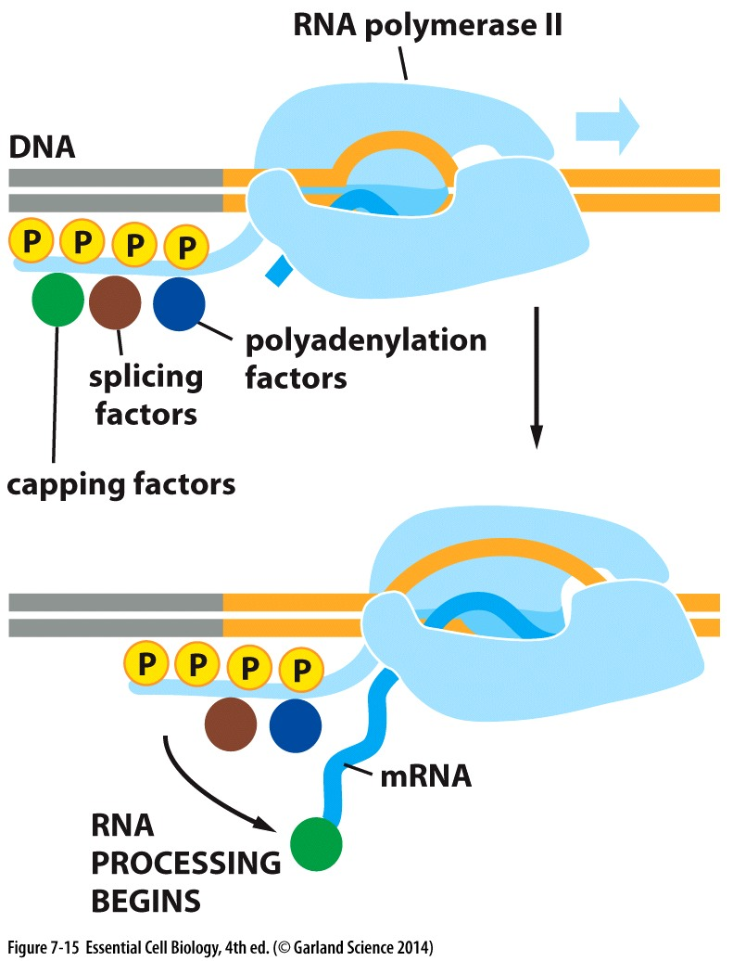
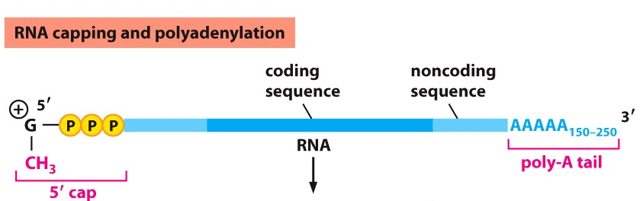
RNA processing
To increase stability, facilitate export to cytoplasm and ‘mark it’ as mRNA
Done concurrent with transcription → necessary factors recruited to RNA pol II phosphorylated tail
RNA capping:
Methylated guanine added to the 5’ end
Polyadenylation:
3’ end is trimmed
Enzymatic reaction to add a repeat of few hundred adenosines (poly- A tail)

Slide 32
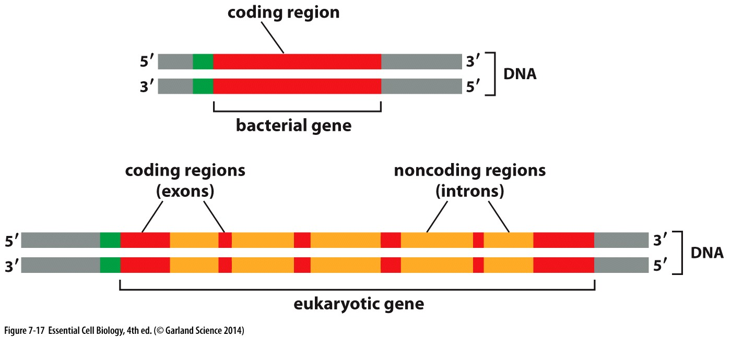
More processing….
Eukaryotic genes can contain non-coding sequences within the coding sequence
Must be removed before mRNA is ready to serve as a template to make protein!

Slide 33
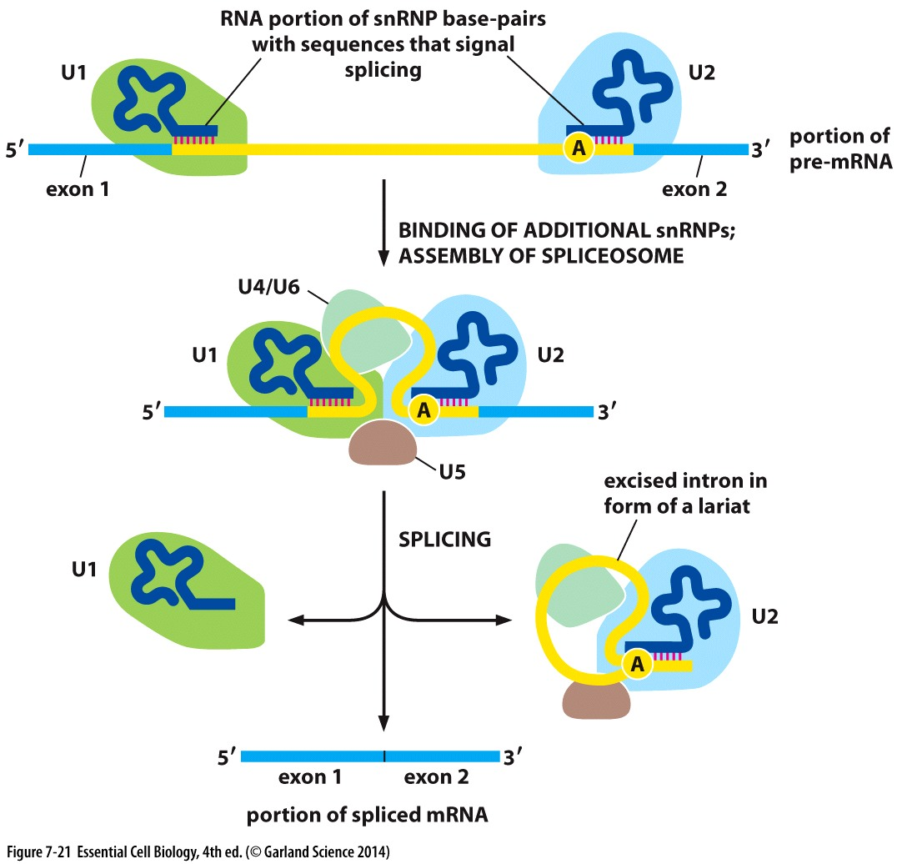
Splicing exons
Begins before transcription completes
Specific sequences near the start and end of introns recruit RNA-based splicing machinery called the spliceosome
Splicing machinery uses RNA called snRNPs to base pair with intron sequences
A chemical reaction excises the intron as a lariat structure, and leaves behind the spliced exons

Slide 34
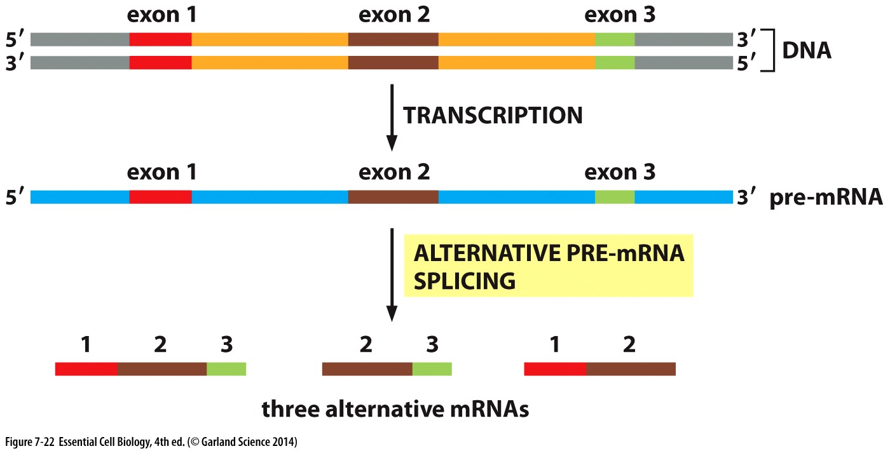
Variation with alternative splicing
Mix and match exons to create different functional proteins
Similar approaches with exons from different proteins create novel fusion proteins ** boost evolution**

Slide 35
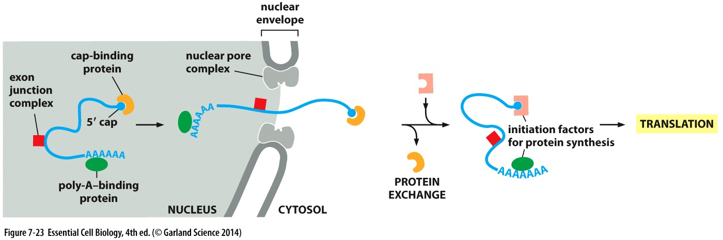
RNA transcription-
Ready for translation!

Slide 36
Protein translation

Slide 37
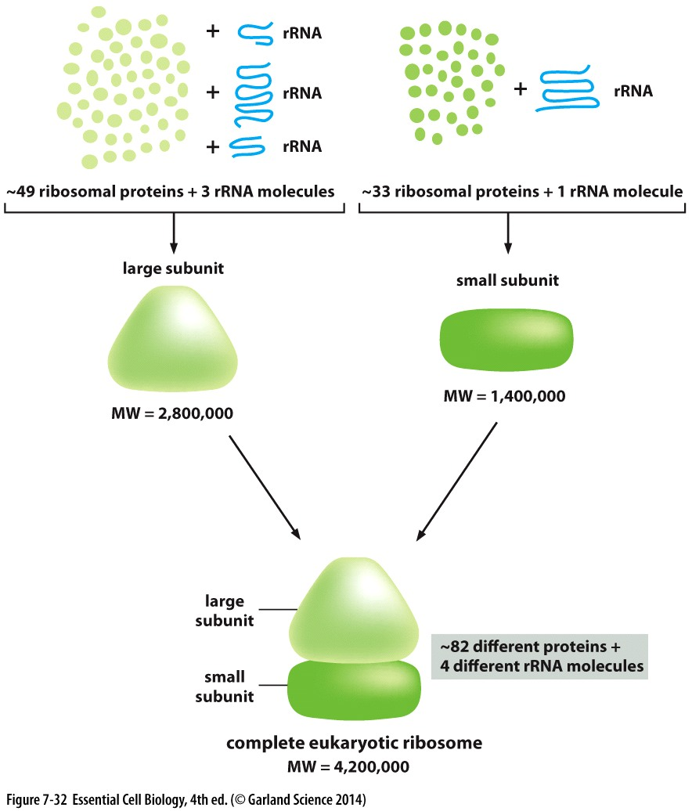
Ribosome synthesizes protein
Mature messenger RNA (mRNA) is ‘read’ by the ribosome
Ribosome translates the mRNA sequence and synthesizes a corresponding peptide
Ribosome: HUGE protein complex
2 subunits
>80 proteins
4 rRNA (ribosomal RNA)

Slide 38
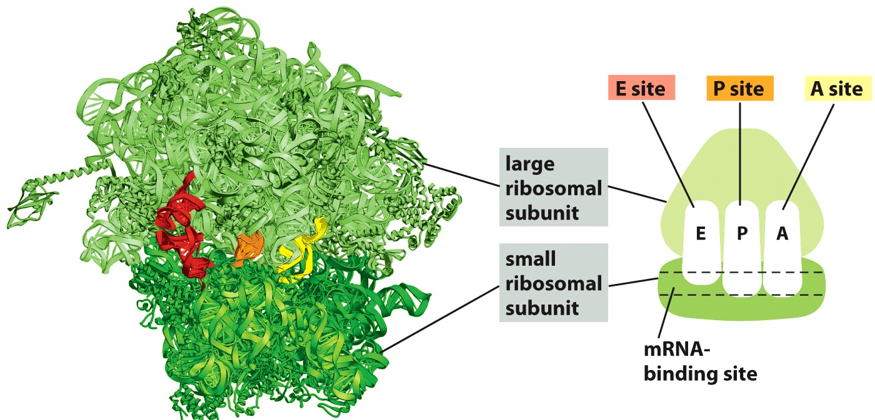
Ribosome is an enzyme complex
Peptidyl-tRNA site
Exit site
Aminoacyl-tRNA site
Ribosome catalyzes the formation of peptide bonds between amino acids in a growing peptide chain
Binding sites for:
mRNA (template)
Three different Amino acid-bound tRNAs

Slide 39
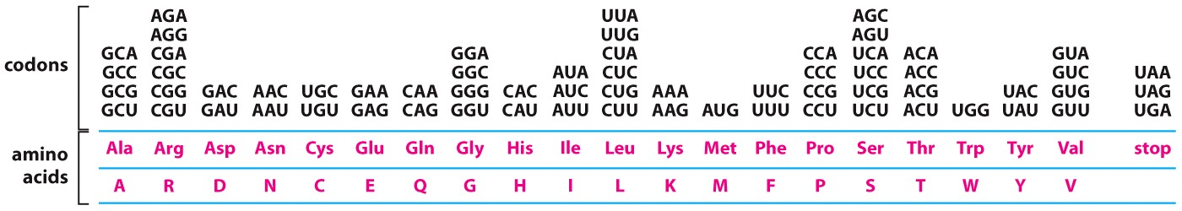
Reading and translating mRNA’s code
Ribosome reads mRNA in groups of 3 bases = codons
Each amino acid is encoded for by one or more distinct codon
Ribosome can recruit specific amino acids based on the mRNA codon sequence

Slide 40
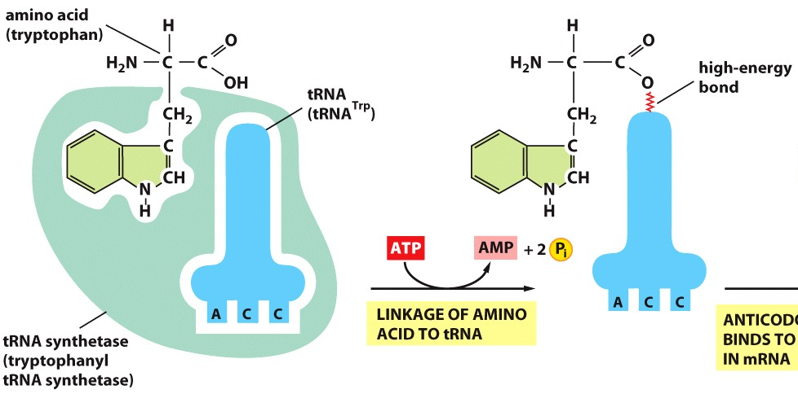
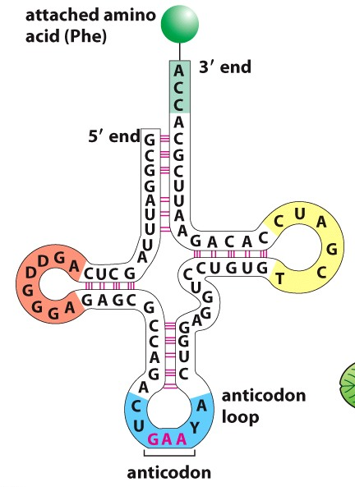
tRNAs match amino acids to mRNA sequence
tRNAs (transfer RNAs):
fold into a 3D ‘cloverleaf’ shape
Contain a 3 nucleotide anticodon which base pairs with a 3 nucleotide codon sequence in mRNA
Are linked to an amino acid specified by anticodon sequence
Synthetase recognizes nucleotide sequences
Amino acids are coupled to tRNAs by the enzyme aminoacyl-tRNA synthetase
One synthetase per amino acid
tRNA loaded with an amino acid is charged

Slide 41
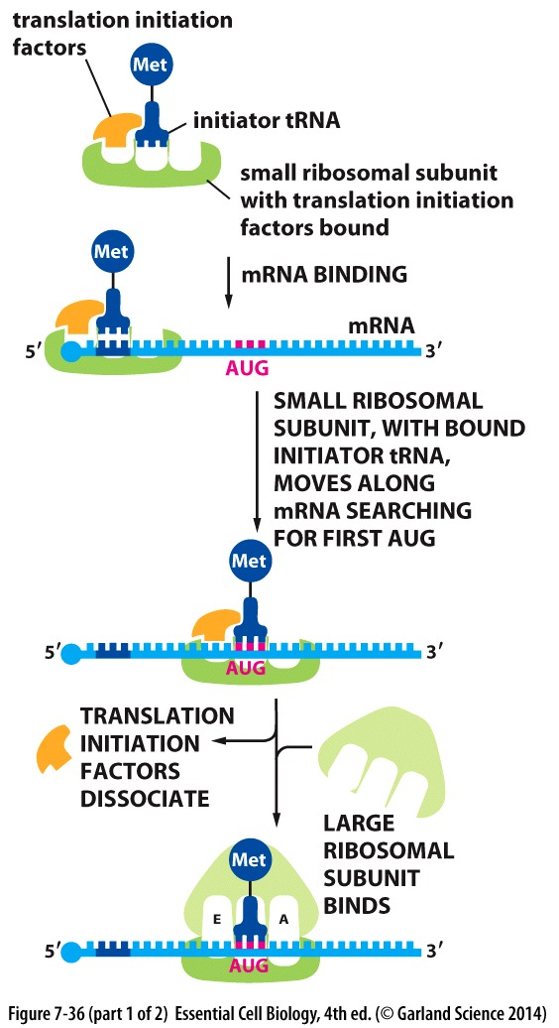
Protein Synthesis
Initiation of translation requires:
Initiation factors that bind ribosome
Proteins that bind and recognize 5’ cap and polyA tail on mRNA
Initiator tRNA → recognizes AUG sequence = START translation
When the AUG is found:
Initiation factors dissociate
Large subunit binds

Slide 42
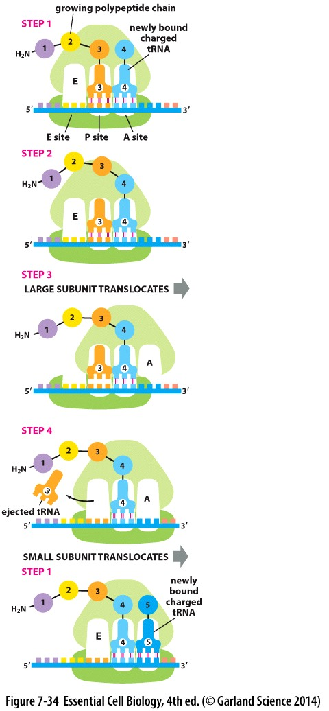
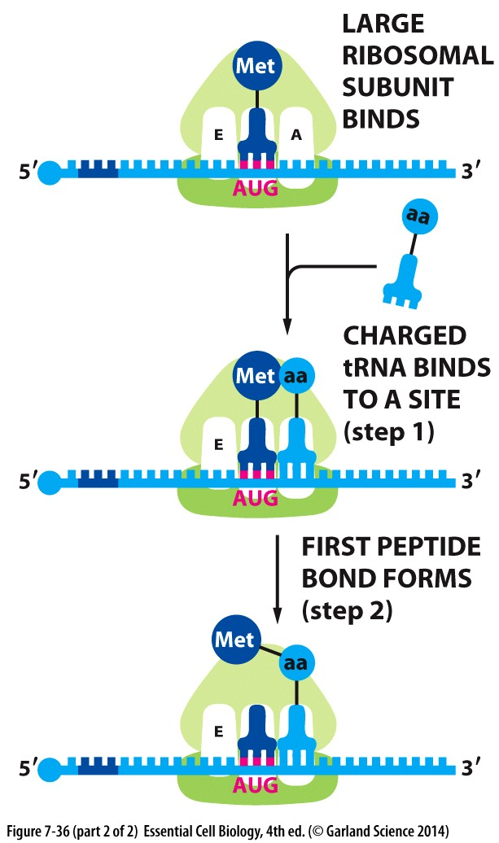
Protein Synthesis
Once AUG start is found:
Charged tRNA is recruited based on codon/anticodon pairing
Ribosome catalyzes peptide bond formation: in P site
Large subunit translocates → moving Met tRNA to E site and first amino acid tRNA to P site
Small subunit translocates and tRNA in E site is ejected
New charged tRNA is recruited to the A site based on codon/anticodon pairing
Repeat

Slide 43
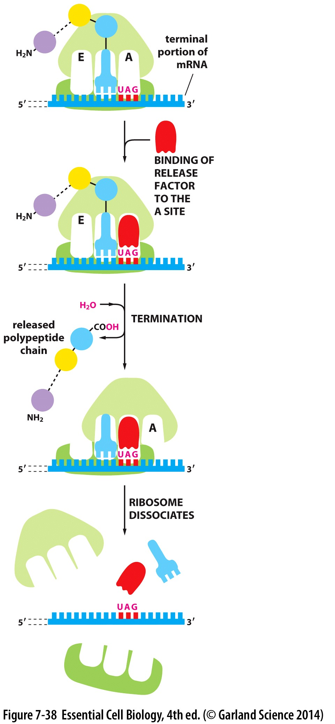
Protein Synthesis
Synthesis continues until UAG codon is reached
UAG = STOP
Release factor is recruited
Polypeptide chain is released
Ribosome dissociates
Enzyme: free ribosome can be recycled and reused

Slide 44
Decoding RNA:
RNA is read in sets of 3 nucleotides = codon
Each amino acid is coded for by one or more codon
UGUAGAUUCCUUUAUAUCUGA
Cys Arg Phe Leu Tyr Ile STOP
Ribosome translates
mRNA sequence
Translated protein sequence
What happens if a single base in the DNA/mRNA template is mutated/deleted/skipped?

Slide 45
Decoding RNA:
RNA is read in sets of 3 nucleotides = codon
Each amino acid is coded for by one or more codon
UGUAGAUUCCUUUAUAUCUGA
Cys Arg Phe Leu Tyr Ile STOP
UGUAGAUUCCUUUAUAUCUGA
Val Asp Ser Phe Ile Ser….
Small changes in the DNA or mRNA sequence can have dramatic effects on the polypeptide being made!
Frame shift mutation can change every downstream codon

Slide 46
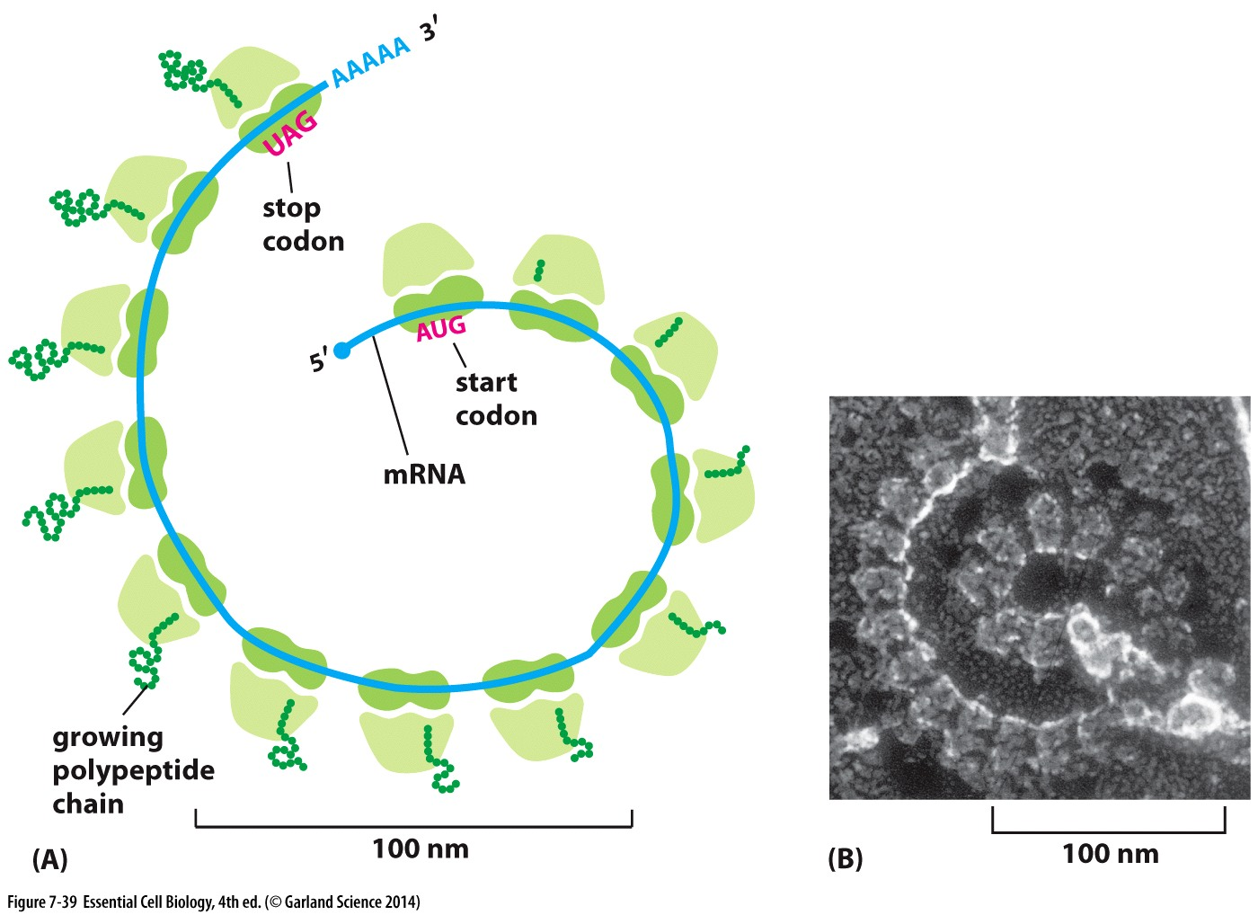
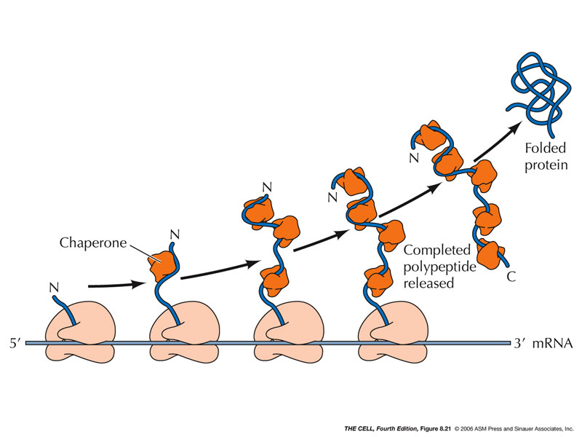
mRNA: a crowded highway!
Multiple ribosomes can bind sequentially → multiple copies of the protein simultaneously
AND the peptide begins folding
while still being translated
-associated chaperones

Slide 47
From DNA to protein: Draw from transcription to translation
Small groups of ~4
5 min or less!

Slide 48
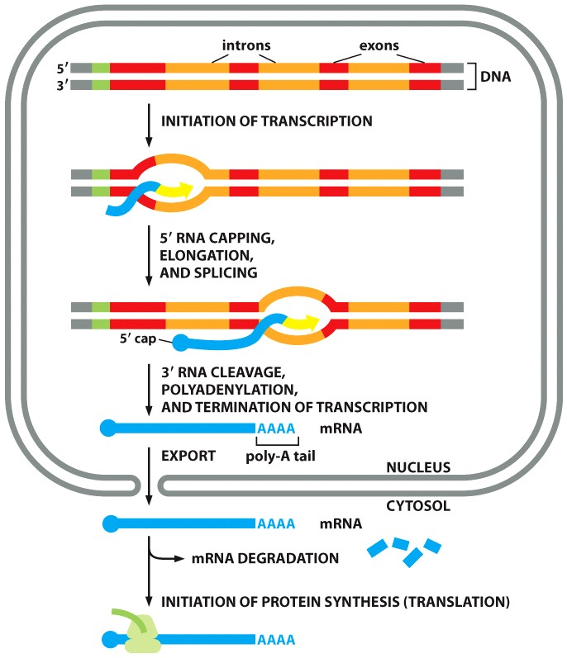
From DNA to protein: Draw from transcription to translation

Slide 49
Consider the process to go from DNA to protein:
mRNA: 1 RNA molecule
Splicesome: 5 RNA molecules
Ribosome: 4 RNA molecules
Initiator tRNA: 1 RNA molecule
Total = 10 RNA molecules to initiate translation

